Slide 1
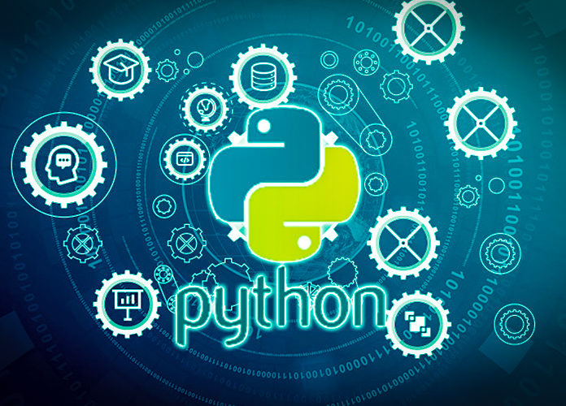
Data Programming in Python _________________ Module 6 Overview

Slide 2

BAIS 6040: Data Programming in Python
Module Objectives:
Basic Plots with Matplotlib
Use AI to aid in graph creation
Construct visualizations based on data analysis

Slide 3
BAIS 6040: Data Programming in Python
In this module:
Matplotlib & Seaborn
Plotting:
Scatterplots & Line Charts
Bar plots & Pie Charts
Box plots & Histograms
Using AI for graph construction

